Slide 1



SMART AGRICULTURE SUPPLY CHAIN TRACKER
PL/SQL Oracle Database Solution KENYA FOCUS
Fatime Dadi Wardougou 25858
Database Development with PL/SQL (INSY 8311)
Adventist University of Central Africa
November 17, 2025
Notes:
1

Slide 2

THE REAL PROBLEM: KENYA'S AGRICULTURAL CHALLENGES
CONCRETE KENYA EXAMPLE:
KENYA-SPECIFIC DATA:
Maize farmer in Trans Nzoia produces 125,391 tons annually
6.3 million households engaged in farming (KNBS 2023)
Post-harvest losses: 20-40% for perishable crops
Transportation delays to Nairobi markets cause 20% spoilage
Supply chain inefficiencies cost billions annually
Price fluctuations between counties cost farmers 30% potential income
Reference: Kenya National Bureau of Statistics - Agricultural Survey
Inefficient routes waste 25% in fuel costs
Notes:
2

Slide 3




CASE STUDY: MAIZE TRANSPORT FROM TRANS NZOIA TO NAIROBI
PROBLEM SCENARIO:
WITH OUR SYSTEM:
Trans Nzoia produces 125,391 tons of maize annually
Real-time route optimization via Eldoret-Nakuru alternative
Truck breakdowns on Eldoret-Nairobi highway cause 2-day delays
Moisture exposure reduces quality and market price by 40%
Moisture sensors trigger immediate protective measures
Farmers receive only 60% of potential revenue
Market price alerts suggest optimal selling times
Estimated outcome: 85% value preservation
Harvesting
Loading
Transportation
Market Delivery
Notes:
3

Slide 4

WHO BENEFITS IN KENYA?
PRIMARY USERS:
IMPACT MEASUREMENT:
Smallholder Farmers (from data: 6.3 million households)
Reduced spoilage: 30% → 12% target
Transport Companies (serving 47 counties)
Increased farmer income: 20-35% improvement
Agricultural Cooperatives (e.g., maize, coffee, tea cooperatives)
Transportation efficiency: 25% fuel savings
Better price realization across counties
County Government Officials (agriculture departments)
Notes:
4

Slide 5

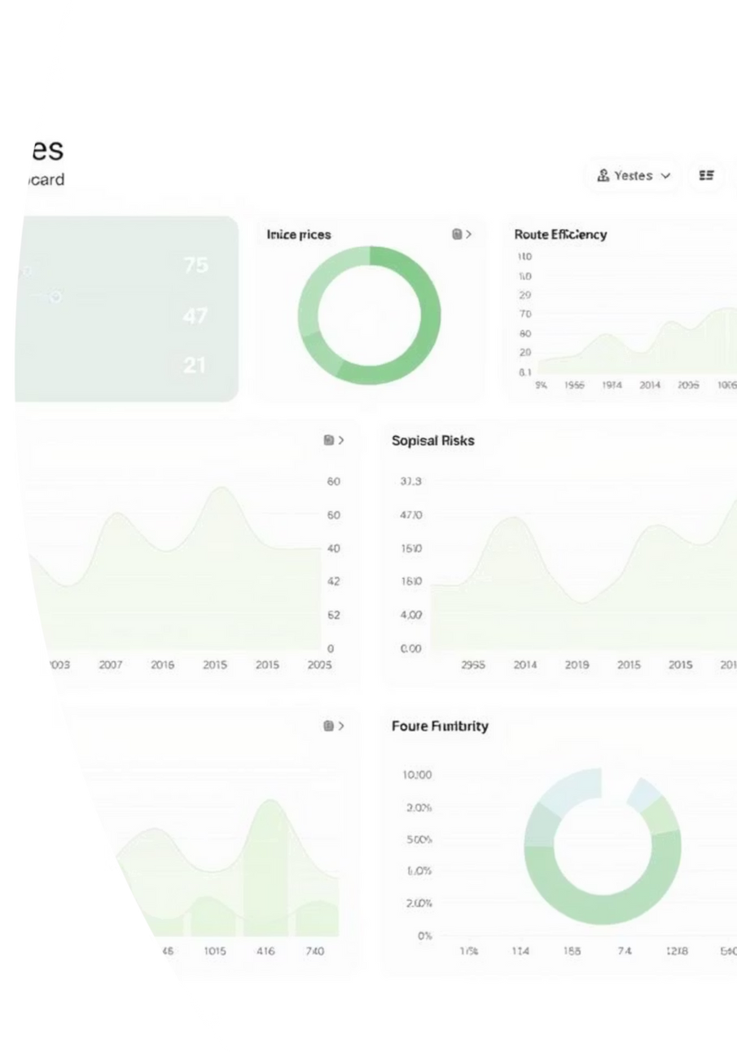
BUSINESS INTELLIGENCE - KENYA FOCUS
DATA-DRIVEN DECISIONS:
PREDICTIVE ANALYTICS:
Transporters: Most efficient inter-county routes
"Maize prices in Nairobi will peak next week - recommend holding shipment"
County-level production vs market demand gaps
"Tomato oversupply predicted in Kiambu - divert to undersupplied markets"
Spoilage risk alerts by crop type
Farmers: Optimal selling time based on county price patterns
County Governments: Strategic storage facility placement
DASHBOARDS DEVELOPED:
EXECUTIVE SUMMARY • KPI cards, county comparison
AUDIT DASHBOARD • Compliance monitoring, violations
PERFORMANCE DASHBOARD • Resource utilization, trends
Notes:
5

Slide 6
PL/SQL & Technology Stack
TECHNOLOGY USED:
• Oracle Database 21c
• PL/SQL for business logic
• Power BI for visualization & Excel for data import/export
PL/SQL COMPONENTS:
• 8+ stored procedures
• 5+ functions for calculations
• Comprehensive packages & Dynamic SQL for flexibility
KEY ACHIEVEMENTS:
• Automated data validation
• Real-time aggregation & Error handling & logging
Notes:
6

Slide 7
Advanced Database Capabilities
BUSINESS RULES:
• Automated compliance checks & Validation constraints
• Referential integrity •
Data quality enforcement
AUDITING SYSTEM:
• Triggers for all DML operations
• Complete change history
• User activity tracking
• Compliance audit trails
SECURITY FEATURES:
• Role-based access control
• Data encryption at rest
• Secure authentication
• Activity monitoring
Notes:
7

Slide 8
Achievements & Next Steps
WHAT WE ACHIEVED:
✓ Complete end-to-end solution
✓ Automated reporting system
✓ Interactive BI dashboards
✓ Scalable database architecture
LESSONS LEARNED:
• Importance of data validation
• User-centric design matters
• Documentation is critical
• Testing saves time long-term
FUTURE ENHANCEMENTS:
• Mobile data collection app
• Predictive analytics & Integration with weather data
• Real-time SMS alerts for farmers
Thank You!
Contact: Billadadiwordougou@gmail.com
GitHub: https://github.com/Fatime-Dadi/MON_25858_FATIME_AGRISUPPLY_DB
Notes:
8

